Slide 1
Database Management & Descriptive Analytics
HDA Workshop
Khawar Naveed Bhatti, MBA Lecturer in Operational Research & Business Analytics

Slide 2
Lecture Outline
Key concepts and data types
Descriptive analytics methods
Relationships among variables
Categorical vs categorical
Categorical vs numerical
Numerical vs numerical
Excel tools: charts, Pivot Tables, CountIfs
HDA Workshop

Slide 3
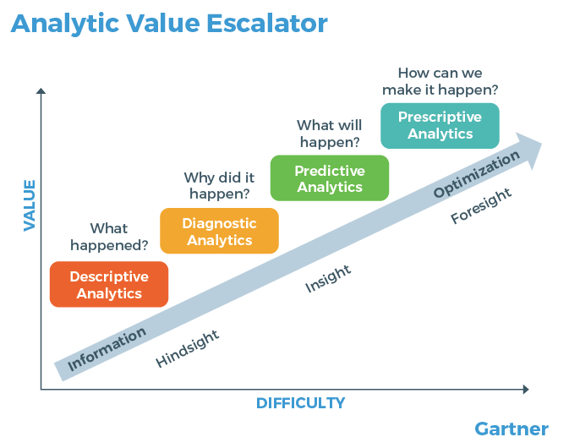
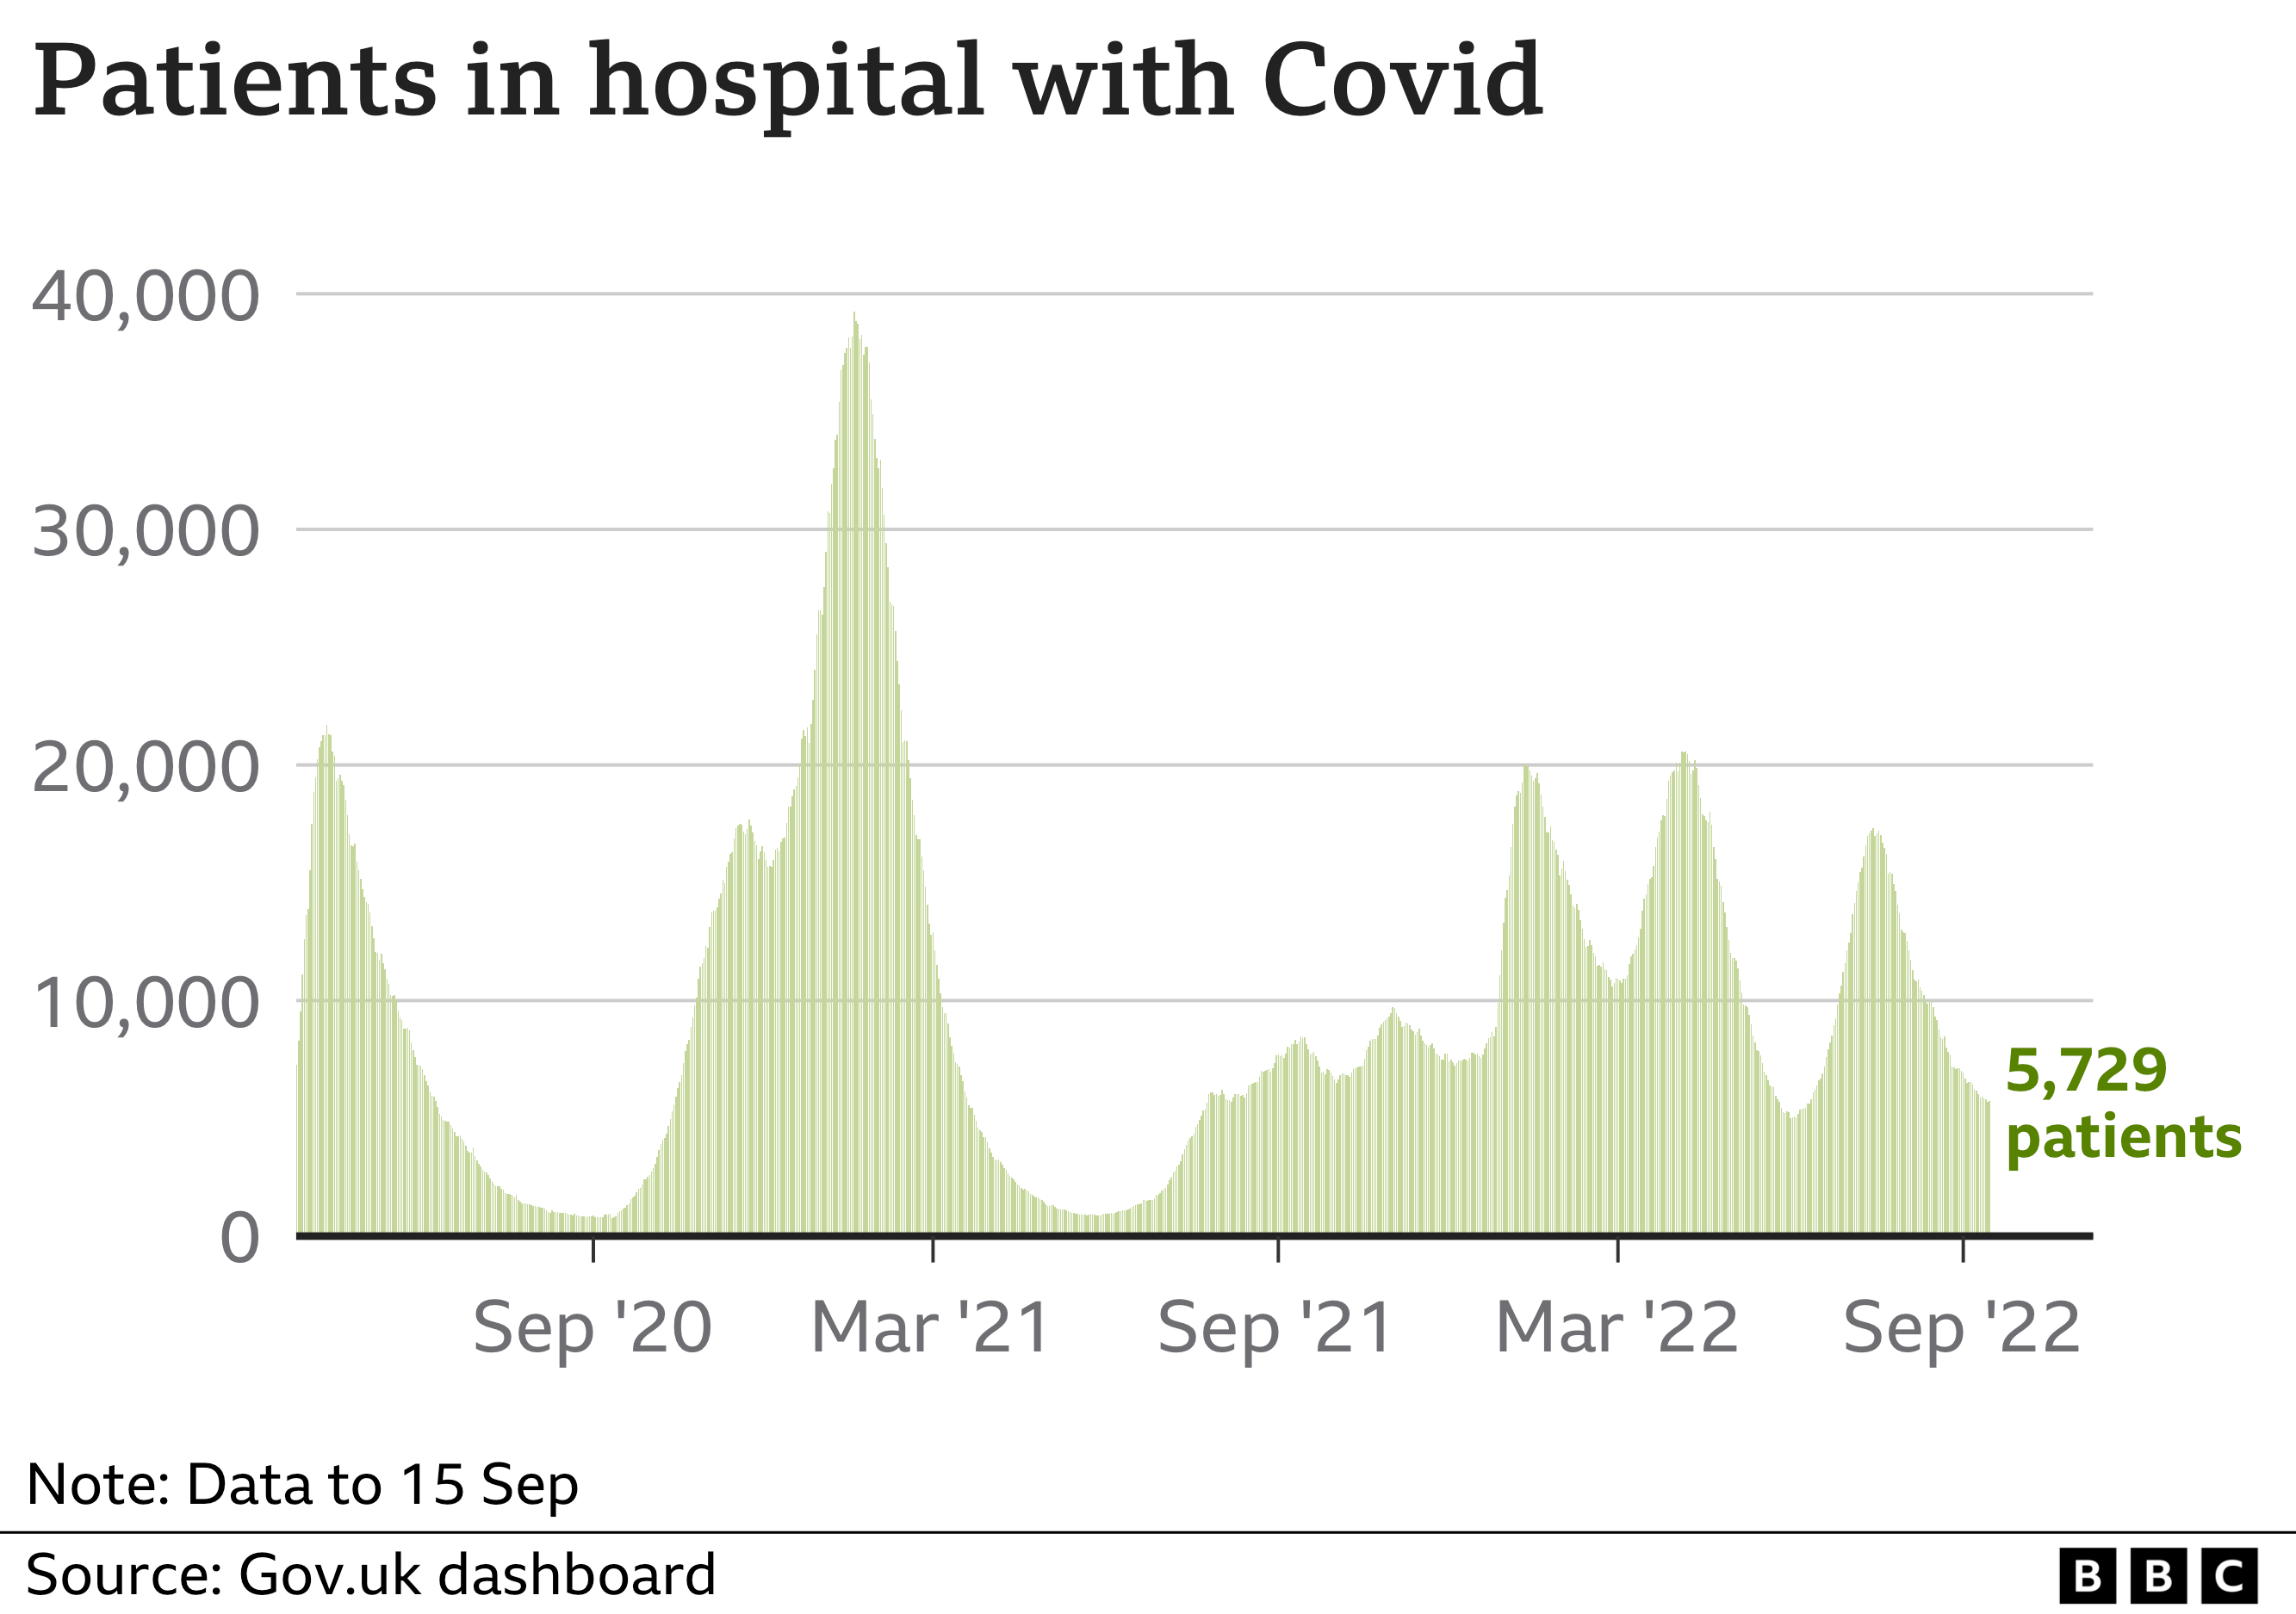

Slide 4
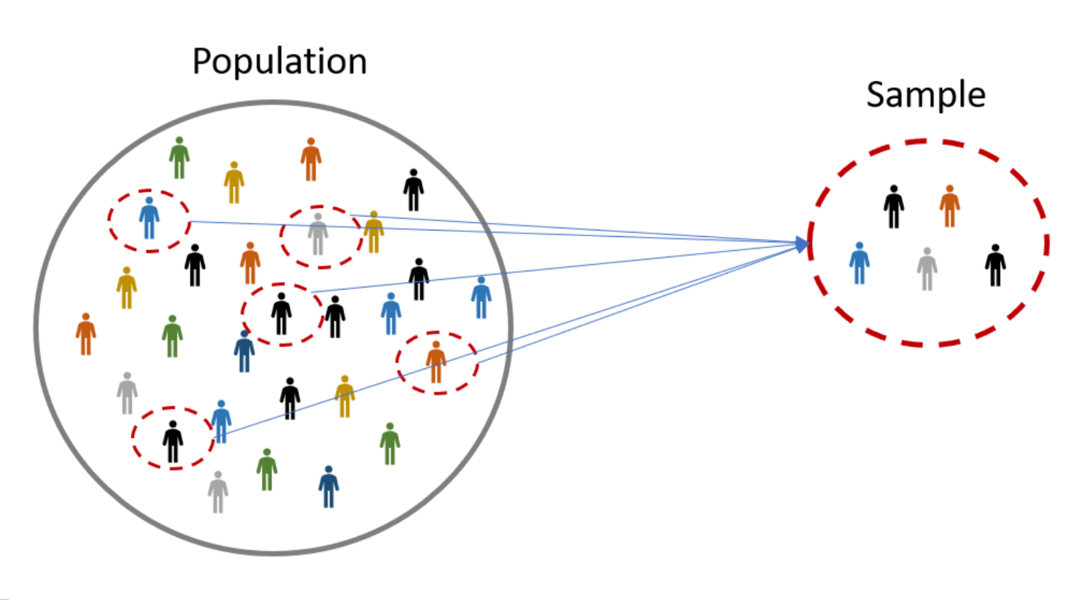
Populations and Samples
A population includes all of the entities of interest in a study (people, households, machines, etc.).
Examples
All potential voters in a presidential election
All subscribers to Netflix
All invoices submitted for Medicare reimbursement by nursing homes
A sample is a subset of the population, often randomly chosen and preferably representative of the population as a whole.
HDA Workshop
KBS 2023

Slide 5
Data Sets, Variables, and Observations
A data set is a collection of data, usually a rectangular array of data, with variables in columns and observations in rows (a database).
A variable (or field or attribute) is a characteristic of members of a population, such as height, gender, or salary.
An observation (or case or record) is a list of all variable values for a single member of a population.
HDA Workshop
KBS 2023

Slide 6
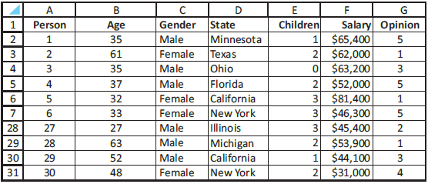
Example: Data from an Environmental Survey
Objective: To illustrate variables and observations in a typical data set.
Data set includes observations on 30 people who responded to a questionnaire on the president’s environmental policies.
Variables include age, gender, state, children, salary, and opinion.
Include a row that lists variable names.
Include a column that shows an index of the observation.
HDA Workshop
KBS 2023
Notes:
Example 2.1 file: Questionnaire Data.xlsx
Figure ﻿2.3﻿ Environmental Survey Data

Slide 7
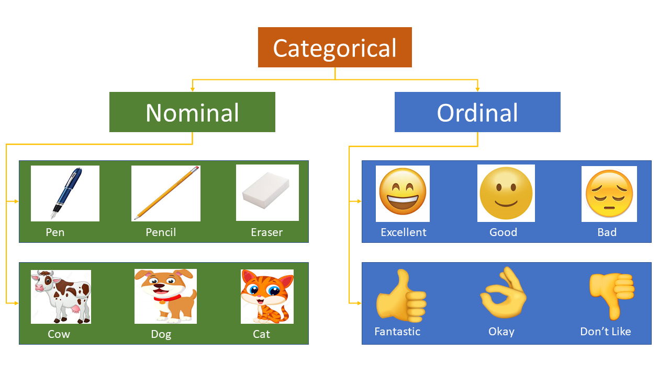
Types of Data
A variable is numerical if meaningful arithmetic can be performed on it.
Otherwise, the variable is categorical.
There is also a third data type, a date variable.
Excel® stores dates as numbers, but dates are treated differently from typical numbers.
A categorical variable is ordinal if there is a natural ordering of its possible values.
If there is no natural ordering, it is nominal.
HDA Workshop
KBS 2023
Notes:
A well-known example of ordinal data is the Likert scale. An example of a Likert scale is:^{[3]:685}
Like, Like Somewhat, Neutral, Dislike Somewhat, Dislike

Slide 8
Types of Data
Categorical variables can be coded numerically.
A dummy variable is a 0–1 coded variable for a specific category.
It is coded as 1 for all observations in that category and 0 for all observations not in that category.
A binned (or discretized) variable corresponds to a numerical variable that has been categorized into discrete categories.
These categories are usually called bins.
HDA Workshop
KBS 2023

Slide 9
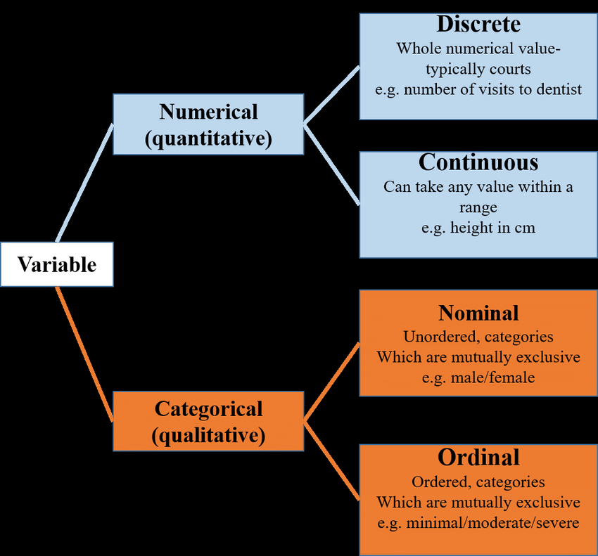
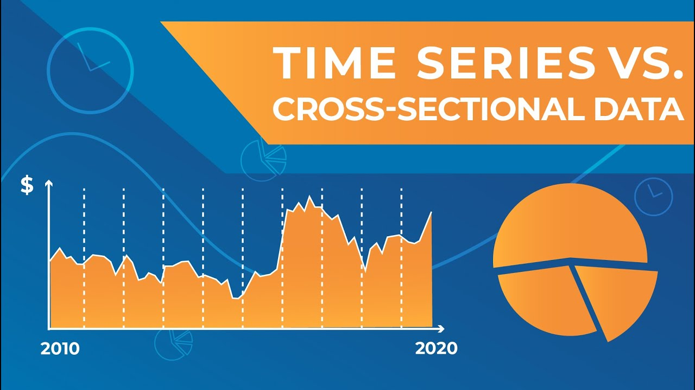
Types of Data
A numerical variable is discrete if it results from a count, such as the number of children.
A continuous variable is the result of an essentially continuous measurement, such as weight or height.
Cross-sectional data are data on a cross-section of a population at a distinct point in time.
Time series data are data collected over time.
HDA Workshop
KBS 2023
Notes:
Cross-sectional data are observations made at the same point in time.
For example, if we want to measure current obesity levels in a population, we could draw a sample of 1,000 people randomly from that population (also known as a cross section of that population), measure their weight and height, and calculate what percentage of that sample is categorized as obese. This cross-sectional sample provides us with a snapshot of that population, at that one point in time. Note that we do not know based on one cross-sectional sample if obesity is increasing or decreasing; we can only describe the current proportion.

Slide 10

Descriptive Analytics Methods
Visualizing and exploring data
Excel charts, sorting data, histograms, PivotTables
Descriptive statistical measures
Mean, median, mode, standard deviation, correlation
Probability Distributions
Normal, binomial, Poisson, exponential
Statistical Inference
Sampling, confidence intervals, hypothesis testing
HDA Workshop
KBS 2023
Notes:
Notion of probability is used everywhere. Important when dealing with uncertainty.
Examples: What is the likelihood that a new product will be profitable? What is the probability that a project will be completed on time?
Probabilities are used to quantify the uncertainty all around us and is an important building block for business analytics applications

Slide 11

Modeling Relationships and Trends in Data
The primary interest in data analysis is usually in relationships between variables.
Different tools are available depending on the type of data.
Create charts to better understand data sets.
For cross-sectional data, use a scatter chart.
For time series data, use a line chart.
Use pivot tables to break down one variable by others so that all sorts of relationships can be uncovered very quickly.
HDA Workshop
KBS 2023

Slide 12
Relationships among Categorical Variables
The most meaningful way to examine relationships between two categorical variables is with counts and corresponding charts of the counts.
You can find counts of the categories of either variable separately, as well as counts of the joint categories of the two variables.
Corresponding percentages of totals and charts help tell the story.
It is customary to display all such counts in a table called a crosstabs (for crosstabulations). This is also sometimes called a contingency table.
HDA Workshop
KBS 2023

Slide 13
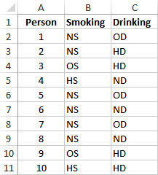
Example: Relationship between Smoking and Drinking
Objective: To use a crosstabs to explore the relationship between smoking and drinking.
Data set lists the smoking and drinking habits of 8761 adults.
Categories have been coded “N,” “O,” “H,” “S,” and “D” for “Non,” “Occasional,” “Heavy,” “Smoker,” and “Drinker.”
HDA Workshop
KBS 2023

Slide 14
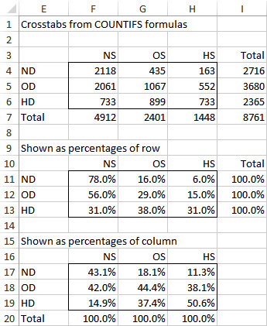
Example: Relationship between Smoking and Drinking
To create the crosstabs, enter the category headings in Excel® and use the COUNTIFS function to fill the table with counts of joint categories.
Next, sum across rows and down columns to get totals.
Then express the counts as percentages of row and percentages of column.
HDA Workshop
KBS 2023

Slide 15
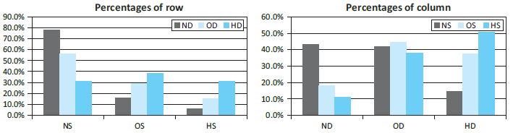
Example: Relationship between Smoking and Drinking
Counts versus percentages
There is no single correct way to display the data in a crosstabs.
Showing the counts as percentages of row totals or percentages of column totals usually makes any relationships stand out more clearly.
Corresponding charts are also very useful.
HDA Workshop
KBS 2023

Slide 16
Relationships among Categorical Variables and a Numerical Variable
The comparison problem is one of the most important problems in data analysis. It occurs whenever you want to compare a numerical measure across two or more subpopulations.
Examples
The subpopulations are males and females, and the numerical measure is salary.
The subpopulations are different regions of the country, and the numerical measure is the cost of living.
The subpopulations are different days of the week, and the numerical measure is the number of customers going to a particular fast-food chain.
HDA Workshop
KBS 2023

Slide 17
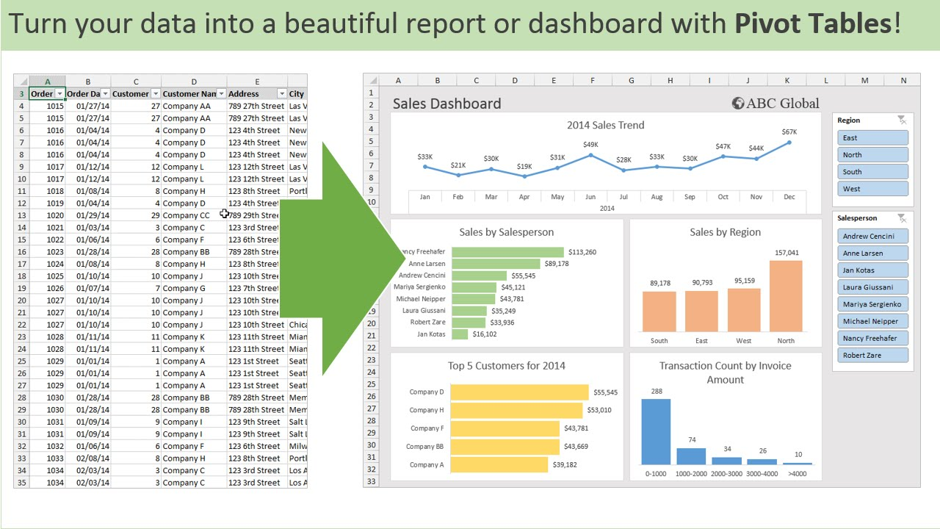
Pivot Tables
The pivot table is an Excel® tool that allows you to break data down by categories.
Sometimes pivot tables are used to display tables of counts, often called crosstabs or contingency tables.
However, crosstabs typically list only counts, whereas pivot tables can list counts, sums, averages, and other summary measures.
HDA Workshop
KBS 2023

Slide 18
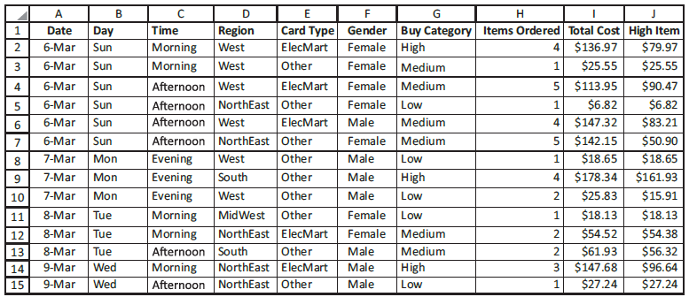
Example: Customer Orders at Elecmart
Objective: To use pivot tables to break down the customer order data by a number of categorical variables.
Data set contains data on 400 customer orders during several months for Elecmart company.
HDA Workshop
KBS 2023

Slide 19
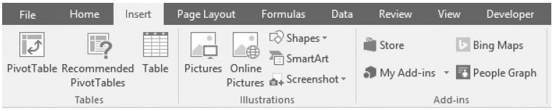
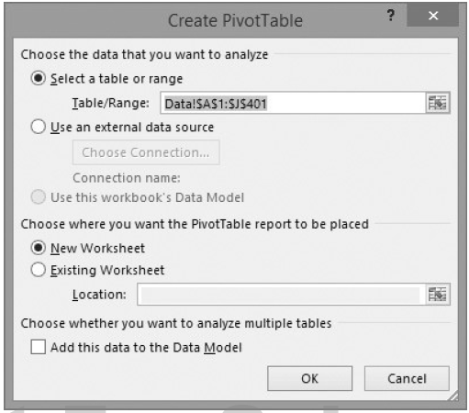
Example: Customer Orders at Elecmart
Create a pivot table by clicking the PivotTable button on the Insert ribbon.
The top section of the dialog box allows you to specify the table or range that contains the data. The bottom section allows you to select the location where you want the results to be placed.
HDA Workshop
KBS 2023

Slide 20
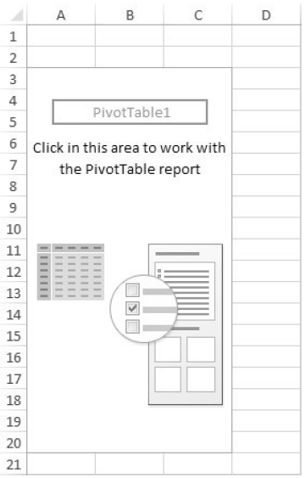

Example: Customer Orders at Elecmart
This produces a blank pivot table.
HDA Workshop
KBS 2023

Slide 21
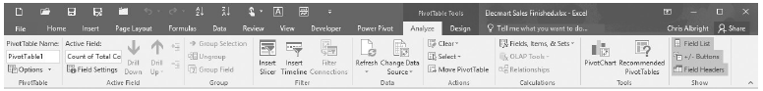
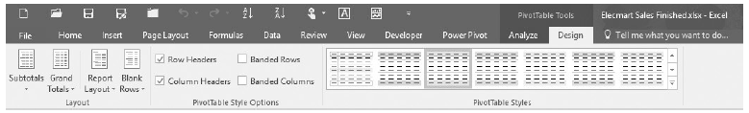
Example: Customer Orders at Elecmart
Assuming any cell inside this blank pivot table is selected, the PivotTable Tools “super tab” is visible.
This super tab has two ribbons, Analyze and Design.
HDA Workshop
KBS 2023

Slide 22
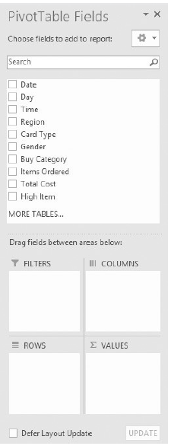
Example: Customer Orders at Elecmart
Finally, the PivotTable Fields pane is visible.
The pane indicates that a pivot table has four areas.
These are for Filters, Rows, Columns, and Values. They correspond to the four areas in a blank pivot table where you can put fields.
HDA Workshop
KBS 2023

Slide 23
Example: Customer Orders at Elecmart
A Rows field has categories that go down the left side of a pivot table.
A Columns field has categories that go across the top of a pivot table.
A Filters field lets you filter the whole pivot table by its categories.
A Values field contains the data you want to summarize.
Typically (but not always), you will place categorical variables in the Filters, Rows, and/or Columns areas, and you will place numeric variables in the Values area.
HDA Workshop
KBS 2023

Slide 24
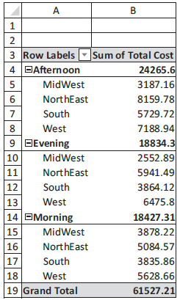
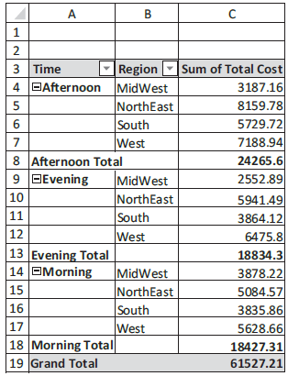
Example: Customer Orders at Elecmart
Check the Time, Region, and Total Cost boxes in the upper half of the PivotTable Fields pane.
Choose from three layouts: Compact, Outline, or Tabular, available from the Report Layout list on the Design ribbon.
HDA Workshop
KBS 2023

Slide 25
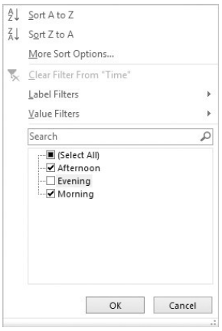
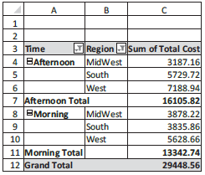
Example: Customer Orders at Elecmart
You can filter out any items in a pivot table that you do not want to see.
Click the Row Labels dropdown arrow of the active field and check the items you want to filter on.
A pivot table with hidden categories is shown below.
HDA Workshop
KBS 2023

Slide 26
Sorting on Values or Categories
It is easy to sort in a pivot table, either by the numbers in the Values area or by the labels in a Rows or Columns field.
To sort by the numbers in the Values area, right-click any number and select Sort.
To sort on the labels of a Rows or Columns field, right-click any of the categories and select Sort.
You can also click the dropdown arrow for the field and get the dialog box that allows both sorting and filtering.
HDA Workshop
KBS 2023

Slide 27
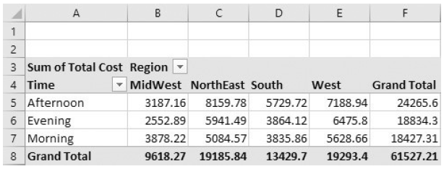
Changing Locations of Fields (Pivoting)
You can choose where to place variables in a pivot table.
For example, to place the Region variable in the Columns area, drag the Region button from the Rows area of the PivotTable Fields pane to the Columns area.
HDA Workshop
KBS 2023

Slide 28
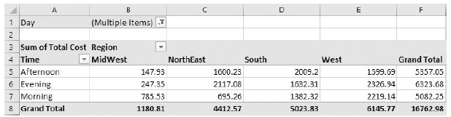
Changing Locations of Fields (Pivoting)
Alternatively, you can categorize by a third field such as Day and locate it in a different area.
If you check Day in the PivotTable Fields pane, it goes to the Rows area by default, but you can then drag it to another area.
HDA Workshop
KBS 2023

Slide 29
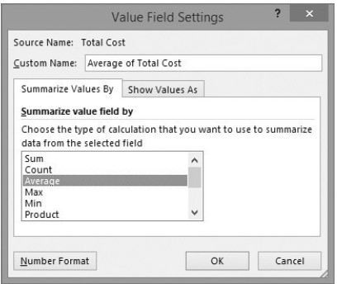

Changing Field Settings
You can change various settings in the Field Settings dialog box.
To get to this dialog box:
Click the Field Setting button on the Analyze/Options ribbon.
OR right-click any of the pivot table cells and select the Field Settings item.
The pivot table with Value Field Settings changed to Average is shown below.
HDA Workshop
KBS 2023

Slide 30
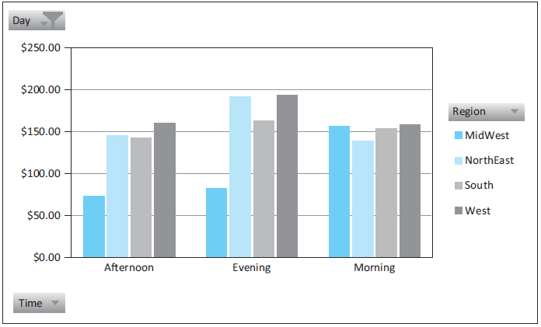
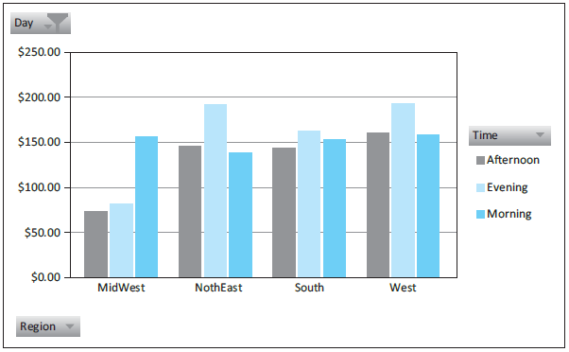
Pivot Charts
It is easy to accompany pivot tables with pivot charts.
These charts adapt automatically to the underlying pivot table.
To create a pivot chart, click anywhere inside the pivot table, select the PivotChart button on the Analyze/Options ribbon, and select a chart type.
HDA Workshop
KBS 2023
Notes:
Figure ﻿3.44﻿ Pivot Chart Based on Pivot Table
Figure ﻿3.45﻿ Pivot Chart after Pivoting Rows and Columns Fields

Slide 31
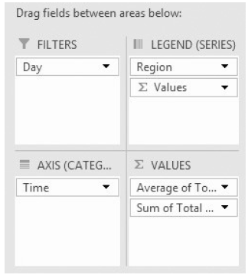
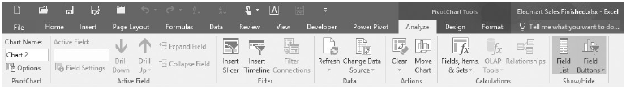
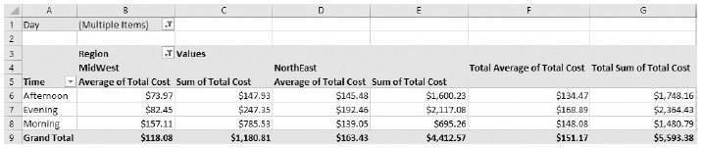
Multiple Variables in the Values Area
More than a single variable can be placed in the Values area.
Also, a given variable in the Values area can be summarized by more than one summarizing function.
HDA Workshop
KBS 2023
Notes:
Figure ﻿3.44﻿ Pivot Chart Based on Pivot Table
Figure ﻿3.45﻿ Pivot Chart after Pivoting Rows and Columns Fields

Slide 32
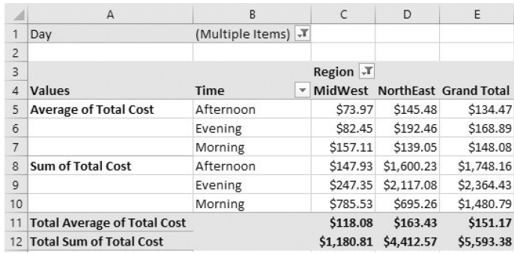
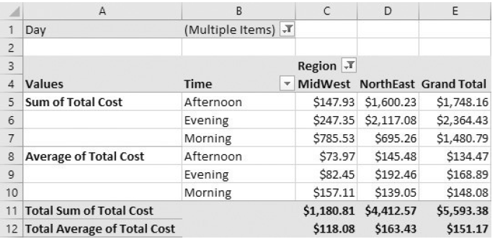
Multiple Variables in the Values Area
HDA Workshop
KBS 2023
Notes:
Figure ﻿3.44﻿ Pivot Chart Based on Pivot Table
Figure ﻿3.45﻿ Pivot Chart after Pivoting Rows and Columns Fields

Slide 33
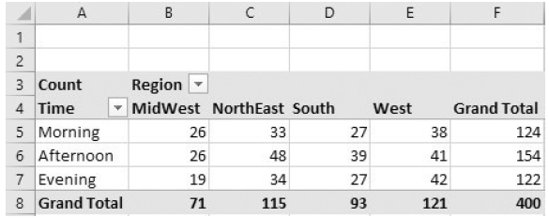
Summarizing by Count
The variable in the Values area can be summarized by the Count function.
This is useful when you want to know, for example, how many of the orders were placed by females in the South.
Right-click any number in the pivot table, select Value Field Settings, and select the Count function.
HDA Workshop
KBS 2023

Slide 34
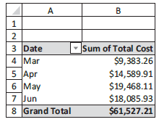
Grouping
Categories in a Rows or Columns variable can be grouped.
Suppose you want to summarize Sum of Total Cost by Date.
Starting with a blank pivot table, check both Date and Total Cost in the PivotTable Fields pane.
Then right-click any date and select Group.
HDA Workshop
KBS 2023

Slide 35
Other Pivot Table Features
Showing/hiding subtotals and grand totals (check the Layout options on the Design ribbon)
Dealing with blank rows, that is, categories with no data (right-click any number, choose PivotTable Options, and check the options on the Layout & Format tab)
Displaying the data behind a given number in a pivot table (double-click any number in the Values area to get a new worksheet)
Formatting a pivot table with various styles (check the style options on the Design ribbon)
Moving or renaming pivot tables (check the PivotTable and Action groups on the Analyze (or Options) ribbon)
Refreshing pivot tables as the underlying data changes (check the Refresh dropdown list on the Analyze (or Options) ribbon)
Creating pivot table formulas for calculated fields or calculated items (check the Formulas dropdown list on the Analyze (or Options) ribbon)
HDA Workshop
KBS 2023

Slide 36
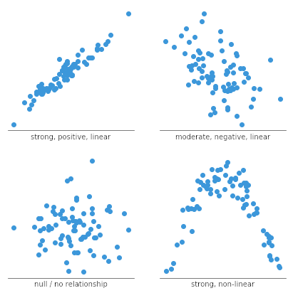
Relationships Among Numerical Variables
To study relationships among numerical variables, a type of chart, called a scatterplot, is used.
A scatterplot is a scatter of points, where each point denotes the values of an observation for two selected variables.
The two variables are often labeled generically as X and Y, so a scatterplot is sometimes called an X-Y chart.
The purpose of a scatterplot is to make a relationship (or the lack of it) apparent.
HDA Workshop
KBS 2023

Slide 37
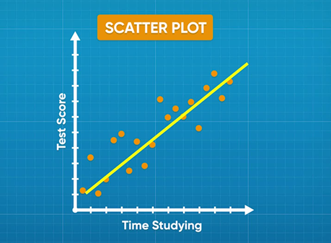
Trend Lines in Scatterplots
Once you have a scatterplot, Excel® enables you to superimpose one of several trend lines on the scatterplot.
A trend line is a line or curve that “fits” the scatter as well as possible.
This could be a straight line, or it could be one of several types of curves.
HDA Workshop
KBS 2023

Slide 38
Common Mathematical Functions
Linear y = a + bx
Logarithmic y = ln(x)
Polynomial (2nd order) y = ax² + bx + c
Polynomial (3rd order) y = ax³ + bx² + dx + e
Power y = ax^{b}
Exponential y = ab^{x}
(the base of natural logarithms, e = 2.71828…is often used for the constant b)
HDA Workshop
KBS 2023

Slide 39
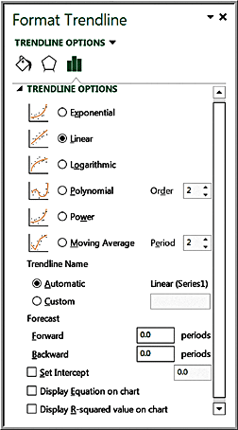
Excel Trendline Tool
Right click on data series and choose Add trendline from pop-up menu
Check the boxes Display Equation on chart and Display R-squared value on chart
HDA Workshop
KBS 2023

Slide 40
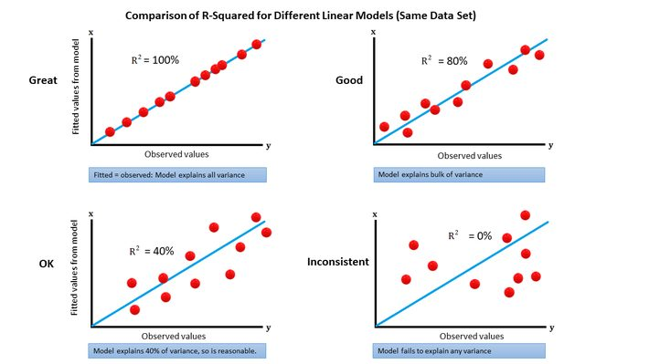
R-Squared
R² (R-squared) is a measure of the “fit” of the line to the data.
The value of R² will be between 0 and 1.
A value of 1.0 indicates a perfect fit and all data points would lie on the line; the larger the value of R² the better the fit.
HDA Workshop
KBS 2023

Slide 41
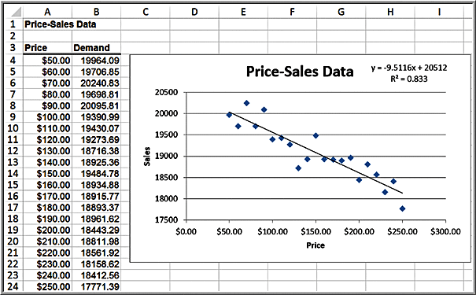
Example: Modeling a Price-Demand Function
Linear demand function:
Sales = 20,512 - 9.5116(price)
HDA Workshop
KBS 2023

Slide 42
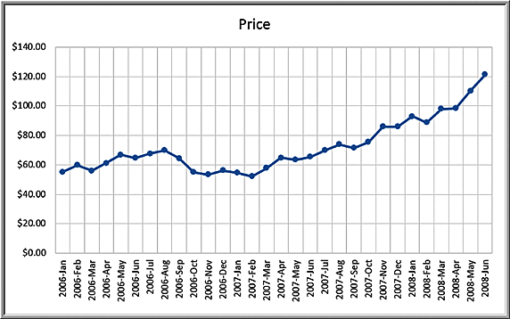
Example: Predicting Crude Oil Prices
Line chart of historical crude oil prices
HDA Workshop
KBS 2023

Slide 43
Example: Predicting Crude Oil Prices
Excel’s Trendline tool is used to fit various functions to the data.
Exponential y = 50.49e^{0.021x} R ² = 0.664
Logarithmic y = 13.02ln(x) + 39.60 R ² = 0.382
Polynomial 2° y = 0.13x ² − 2.399x + 68.01 R ² = 0.905
Polynomial 3° y = 0.005x ³ − 0.111x ²
+ 0.648x + 59.497 R ² = 0.928 *
Power y = 45.96x ^{0.0169} R ² = 0.397
HDA Workshop
KBS 2023

Slide 44
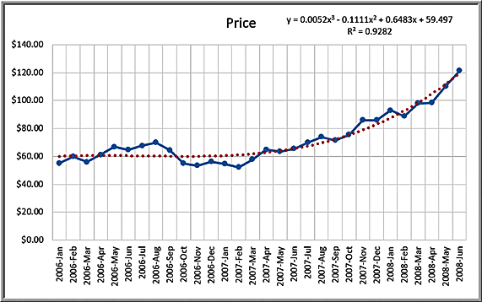
Example: Predicting Crude Oil Prices
Third order polynomial trendline fit to the data
HDA Workshop
KBS 2023

Slide 45
Caution About Polynomials
The R² value will continue to increase as the order of the polynomial increases; that is, a 4th order polynomial will provide a better fit than a 3rd order, and so on.
Higher order polynomials will generally not be very smooth and will be difficult to interpret visually.
Thus, we don't recommend going beyond a third-order polynomial when fitting data.
Use your eye to make a good judgment!
HDA Workshop
KBS 2023

